Slide 1
Pre-Quiz Basic Concepts, Faraday’s Law and CSTR Balances
Learning Objectives Review of ChE 100, ChE 102, ChE 101, ChE 230, ChE 231

Slide 2
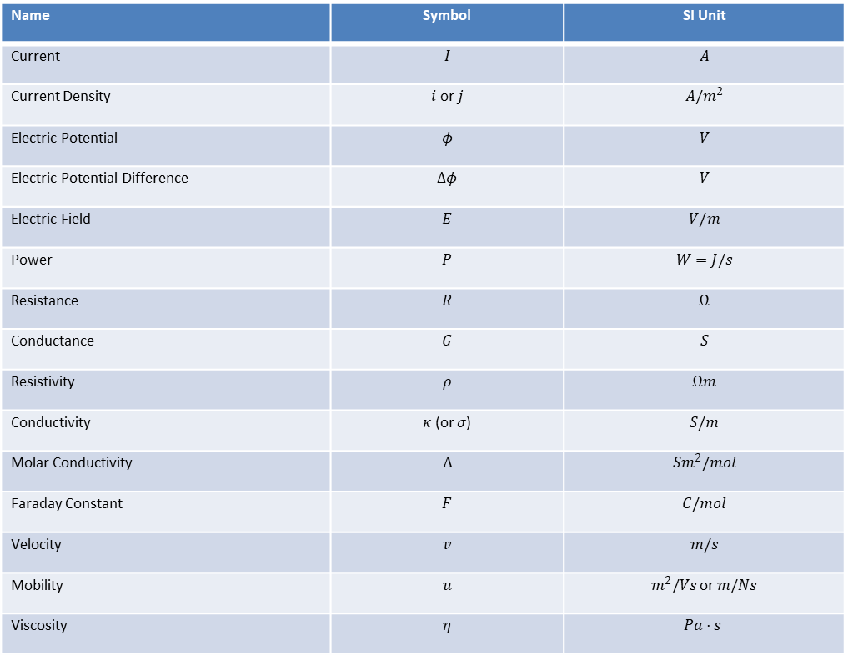
Terminology and Definitions
The following table lists the various properties and their units to be used
throughout this course.
Name | Symbol | SI Unit
Current | $$I$$ | $$A$$
Current Density | $i$ or $j$ | $$A/m^{2}$$
Electric Potential | $$φ$$ | $$V$$
Electric Potential Difference | $$Δφ$$ | $$V$$
Electric Field | $$E$$ | $$V/m$$
Power | $$P$$ | $$W=J/s$$
Resistance | $$R$$ | $$Ω$$
Conductance | $$G$$ | $$S$$
Resistivity | $$ρ$$ | $$Ωm$$
Conductivity | $κ$ (or $σ$) | $$S/m$$
Molar Conductivity | $$Λ$$ | $$Sm^{2}/mol$$
Faraday Constant | $$F$$ | $$C/mol$$
Velocity | $$v$$ | $$m/s$$
Mobility | $$u$$ | $m^{2}/Vs$ or $m/Ns$
Viscosity | $$η$$ | $$Pa⋅s$$

Slide 3
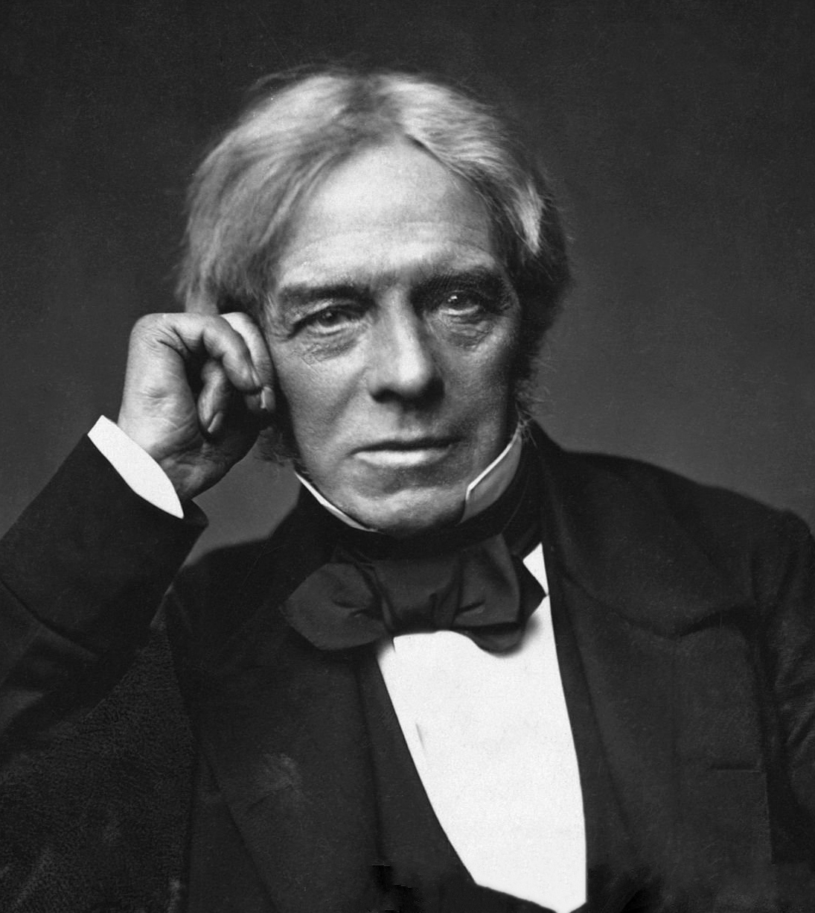
Who is this? Why he important for in ChE 331?
Hints:
- Law
This is Michael Faraday, the person who developed Faraday’s Law, and Faraday’s Law of Electrolysis. Faraday’s Law of Electrolysis allows us to apply the simple concepts of stoichiometry to redox reactions, and determine the number of moles of dissociated ions based on the reaction, and the amount of electricity passed through a galvanic cell.

Slide 4
What is REDOX Reaction. Review of Reduction/Oxidation Reactions
Definition of oxidation state (OS):
Oxidation state is a number assigned to an atom in a compound, indicating the charge that the atom would have if all bonds were completely ionic.
Reduction reaction: a reactant gains electrons at the cathode reactant is negatively charged
Oxidation reaction: a reactant loses electrons at the cathode and the Oxidation state of reactant is increased OR decreased.
⁰

Slide 5
What is the Distinction Between Oxidation and Reduction
What this means:
“An Ox and a Red Cat”
”An Ox and a Red Cat means:
Oxidation occurs at the Anode, and Reduction occurs at the Cathode
LEO -> Loss of Electrons is Oxidation
GER -> Gain of Electrons is Reduction
Draw an Image to help these concepts? Or find a suitable image for these concept:☺☺
See next page for image.

Slide 6
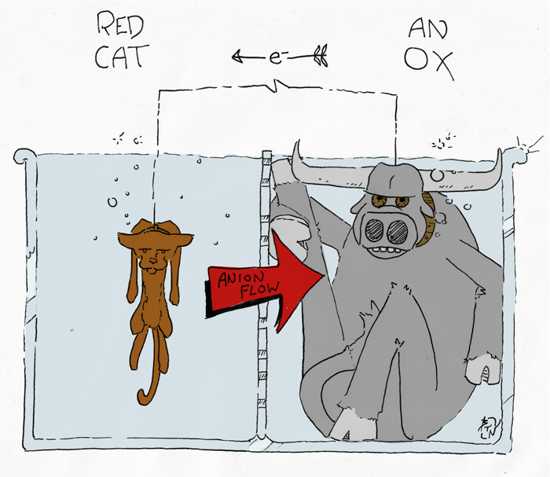
A Nice image
This image was taken from:
https://kaiserscience.wordpress.com/chemistry/electrochemistry/redox-reactions/
To me, this image nicely summarizes a redox reaction. An Ox exists at the anode. This ox is rather plump in electrons, and loses them to the Red Cat (at the cathode).

Slide 7
What are the Rules for Determining Oxidation States? Any other Rules?
For monoatomic species, the oxidation number (O.N.) is the net charge on the atom
Polyatomic
For pure elements, the O.N. is 0
For alkali metals, the O.N. is +1
For alkaline earth metals, the O.N. is +2
For halogens that are not combined with oxygen, or other halogens, the O.N. is -1
Fluorine is always -1
For hydrogen in all compounds except those with bonds to metals, O.N. is +1
When bonded to metals, O.N. of Hydrogen is -1
Generally, Oxygen has a O.N. of -2
When a peroxide, Oxygen has a O.N. of +1
When combined with Fluorine, Oxygen has a O.N. of +2
For all other variants, the O.N. can be chosen so the sum of the O.N. are equal to the net charge of the molecule/ion

Slide 8
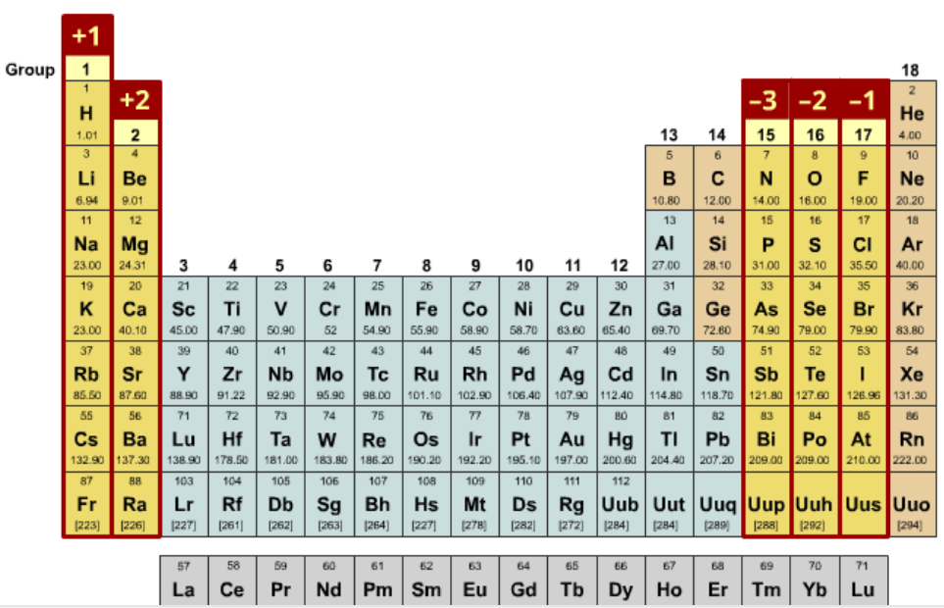
What is this? (You will NOT provided these values needed for your calculations. Get your own.)

Slide 9
The highlighted values in the periodic table are the base oxidation states for those pure elements.

Slide 10
What is CSTR Model for Reactors
As with other chemical reactors, an electrochemical reactor can be modelled as a continuously stirred tank reactor (CSTR)
Main assumptions of CSTR model:
- perfectly mixed contents and uniform concentrations within reactor
∴ discharge concentrations are the same as concentrations within reactor
C_{Mf} , C_{Hf}
q_{f}
V
q
Do molar balances on dissolved species over entire tank or reactor. Do not attempt balances on H₂O (l), solid species or gas.
C_{M} , C_{H}
Note: Only steady-state problems will be given in numerical examples during this course; transient problems may be given if the objective is to formulate, but not solve, mass balances.

Slide 11
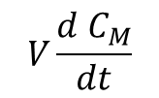
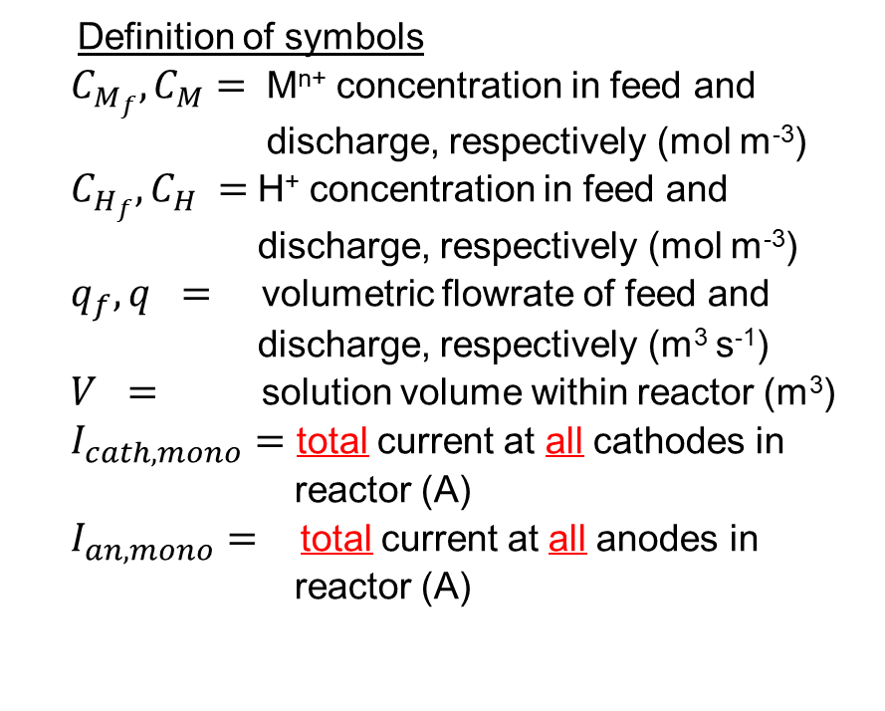

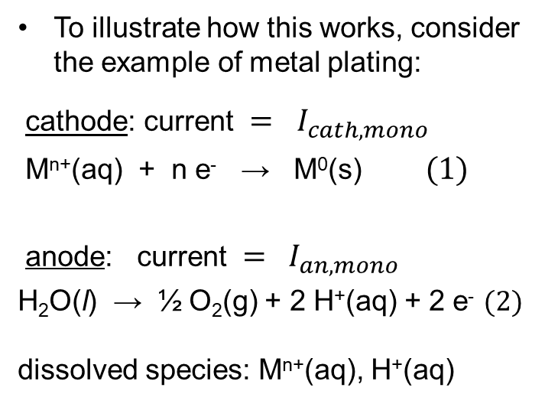
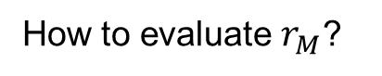
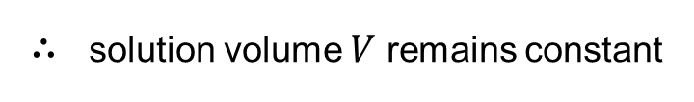
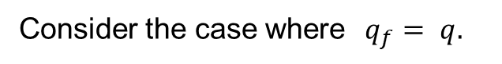
Example 1
Definition of symbols
$C_{M_{f}}, C_{M}=$ M^{n+} concentration in feed and discharge, respectively (mol m⁻³)
$C_{H_{f}}, C_{H} =$H⁺ concentration in feed and discharge, respectively (mol m⁻³)
$q_{f}, q =$ volumetric flowrate of feed and discharge, respectively (m³ s⁻¹)
$V =$ solution volume within reactor (m³)
$I_{cath,mono}$ = total current at all cathodes in reactor (A)
$I_{an,mono}$ = total current at all anodes in reactor (A)
To illustrate how this works, consider the example of metal plating:
cathode: current = $I_{cath,mono}$
M^{n+}(aq) + n e⁻ → M⁰(s) (1)
anode: current = $I_{an,mono}$
H₂O(l) → ½ O₂(g) + 2 H⁺(aq) + 2 e⁻ (2)
dissolved species: M^{n+}(aq), H⁺(aq)
Consider the case where$q_{f}= q.$
∴ solution volume $V$ remains constant
Transient balance on M^{n+} ion:
$$= q C_{M_{f}} − q C_{M} +??____??\left(3\right)$$
$$V\frac{d C_{M}}{dt}$$
How to evaluate $r_{M}$?

Slide 12
Pre- Quiz: Determine the Oxidation States of the Atoms in the Following Species
FeO c) AlF₄⁻ e) AlOOH g) O₂F
LiH d) OCl⁻ f) PO₄³⁻ h) NaO₂
Notes:
Many metals

Slide 14
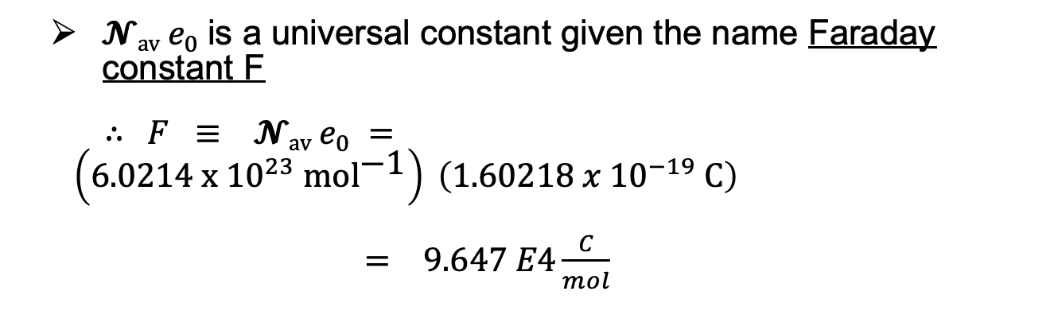
$\text{𝓝}\text{av}{ e}_{0}$ is a universal constant given the name Faraday constant F
∴ $F ≡ \text{𝓝}\text{av}{ e}_{0} = \left(6.0214 \text{x} {10}^{23} {\text{mol}}^{\text{−1}}\right) \left(1.60218 x {10}^{−19} \text{C}\right)$
$= 9.647 E4\frac{C}{mol}$
charge associated with an Avogadro’s number of electrons

Slide 15
END FOR Pre - QUIZ Set-up for Lecture Problems for 11 Jan See below
Lectures will not be posted the complete solution Lecture Problems. Students must be in class to get the complete the Lecture problem.
Midterms and Exam can be used Quizzes, Assignments and Lecture Problems in the exams but they must be written in your own writing.

Slide 16
Examples of Applying Faraday’s Law
Lecture Example:
Apply Faraday’s law to describe the current in terms of the production rates of Pb and PbO₂ in a lead-acid battery:
Pb(s) + PbO₂(s) + 2HSO₄⁻(aq) + 2H⁺(aq) → 2PbSO₄(s) + 2H₂O(l)

Slide 18
Pb Plating Lecture Example
Electrolytic cell

Slide 19
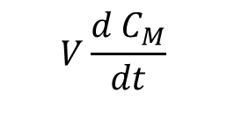
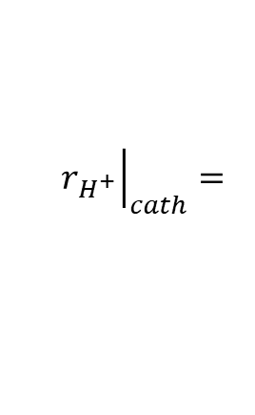
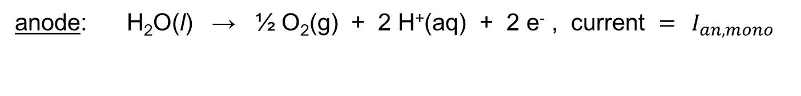
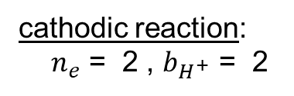
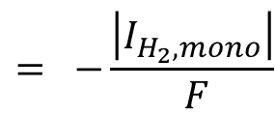
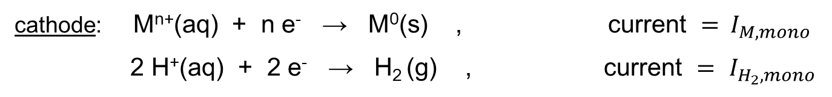
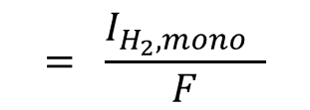
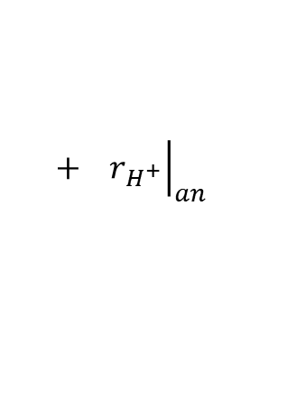
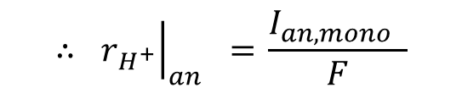
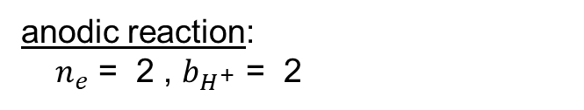
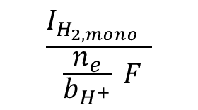
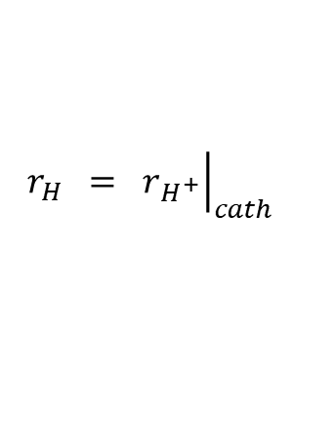

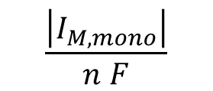
Lecture Example
As a final example, consider the following reactions in a monopolar cell.
cathode: M^{n+}(aq) + n e⁻ → M⁰(s) , current = $I_{M,mono}$
2 H⁺(aq) + 2 e⁻ → H₂ (g) , current = $I_{H_{2},mono}$
anode: H₂O(l) → ½ O₂(g) + 2 H⁺(aq) + 2 e⁻ , current = $I_{an,mono}$
dissolved species: M^{n+}(aq), H⁺(aq)
$$V\frac{d C_{M}}{dt}$$
$$\frac{\left|I_{M,mono}\right|}{n F}$$
M^{n+}$: = q C_{M_{f}}−q C_{M} −$
these are all total currents at all cathodes or anodes in reactor
H⁺: H⁺ is consumed at the cathode, but also generated at the anode.
What is $r_{H}$ ?
$$r_{H} = {\left.r_{H^{+}}\right|}_{cath}$$
$$+ {\left.r_{H^{+}}\right|}_{an}$$
cathodic reaction:
${ n}_{e}$ = 2 , $b_{H^{+}}$ = 2
$$\frac{I_{H_{2,mono}} }{ \frac{n_{e}}{b_{H^{+}}} F}$$
$$= \frac{I_{H_{2},mono} }{F}$$
$$= −\frac{\left|I_{H_{2},mono}\right|}{ F}$$
$${\left.r_{H^{+}}\right|}_{cath}=$$
anodic reaction: $n_{e}$ = 2 , $b_{H^{+}}$ = 2
$$\text{∴ }{\left.r_{H^{+}}\right|}_{an} \text{=} \frac{I_{an,mono} }{F}$$

Slide 20
Nickel Plating Example (two pages)

Slide 21
Assume the system is operating under steady-state conditions.

